Slide 1
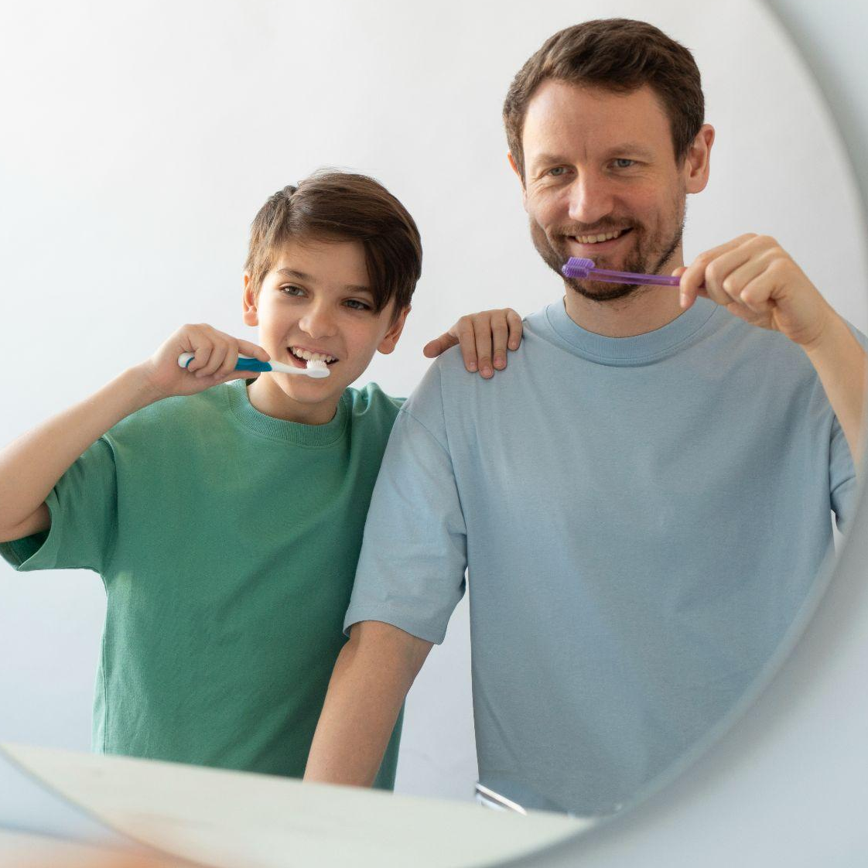

WELCOME TO THE PATTERNS COMPANY

Slide 2
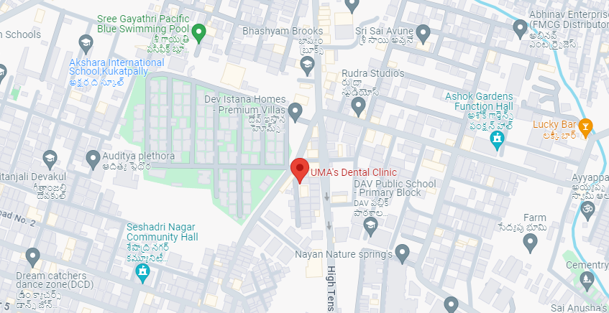

Geographic Location KPHB/JNTU/KUKATAPALLI
https://umasdentalclinic.com/
Flat No:F3 House No: 205/c, Addagutta, co-op.Society, Near JNTU Kukatpalli, hyd.

Slide 3
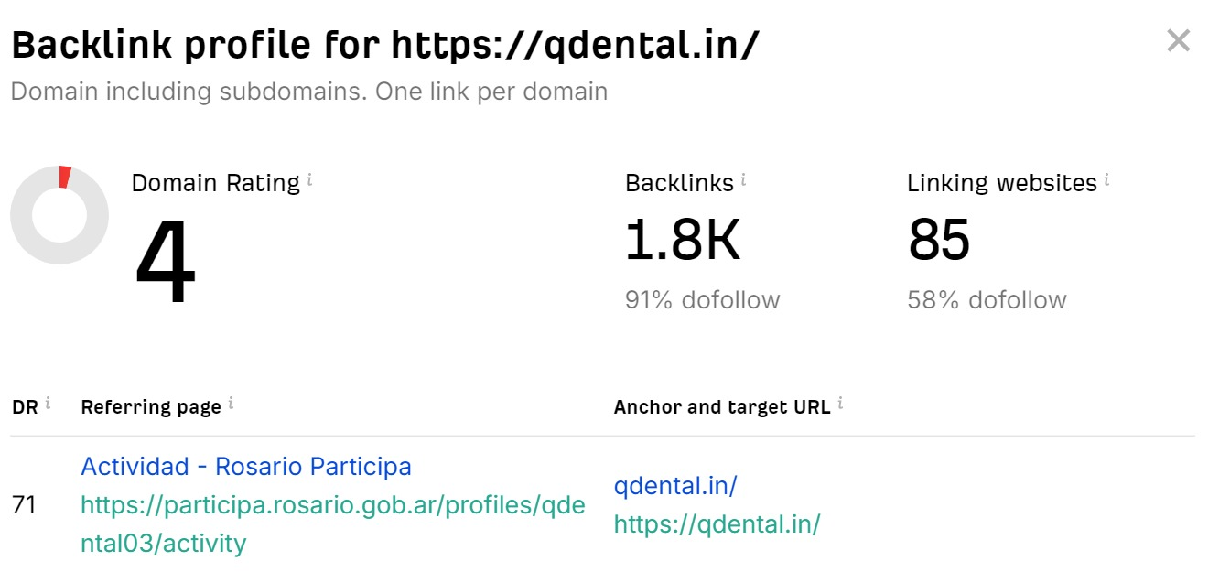
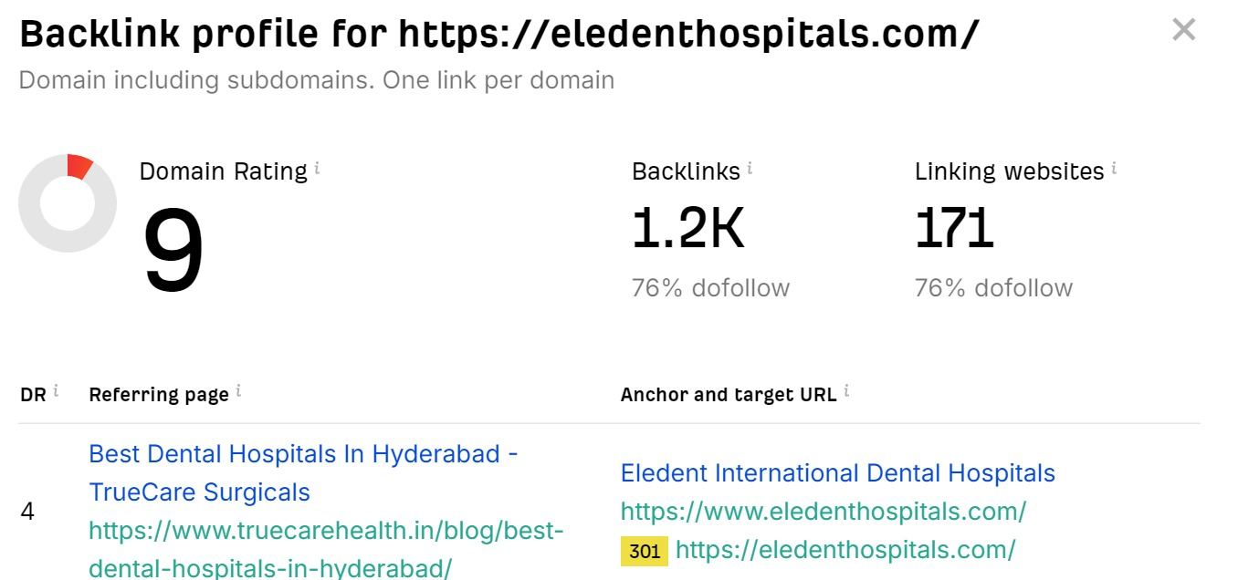
Competitors Of Uma Dental Clinic
02
01
Q Dental
Eledent Hospitals

Slide 4
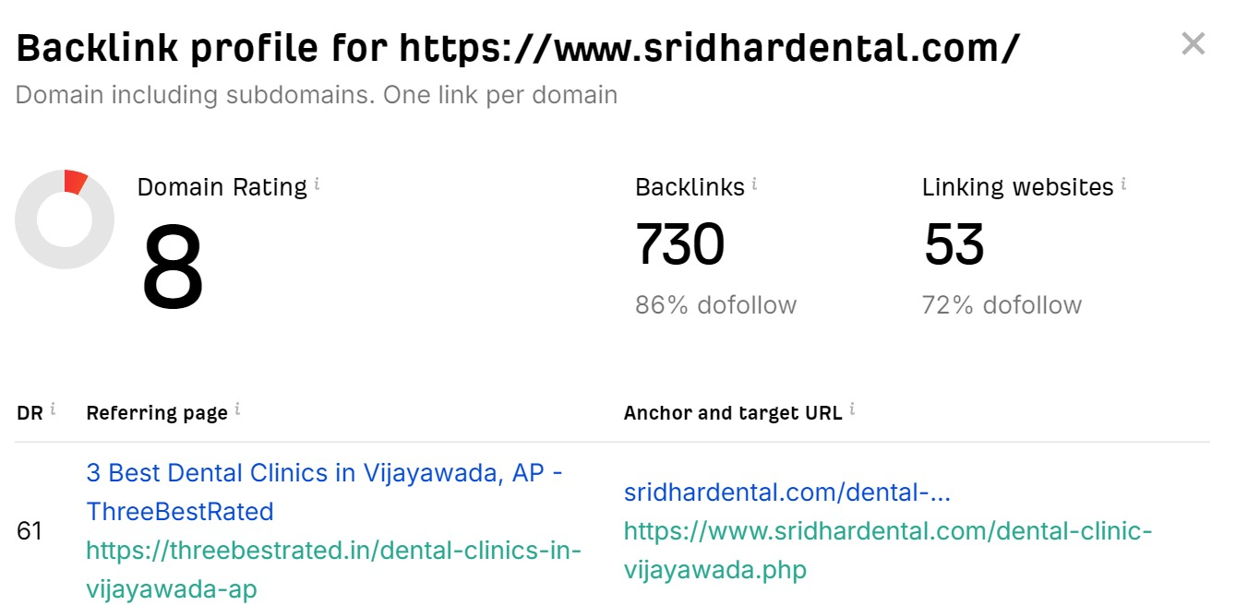
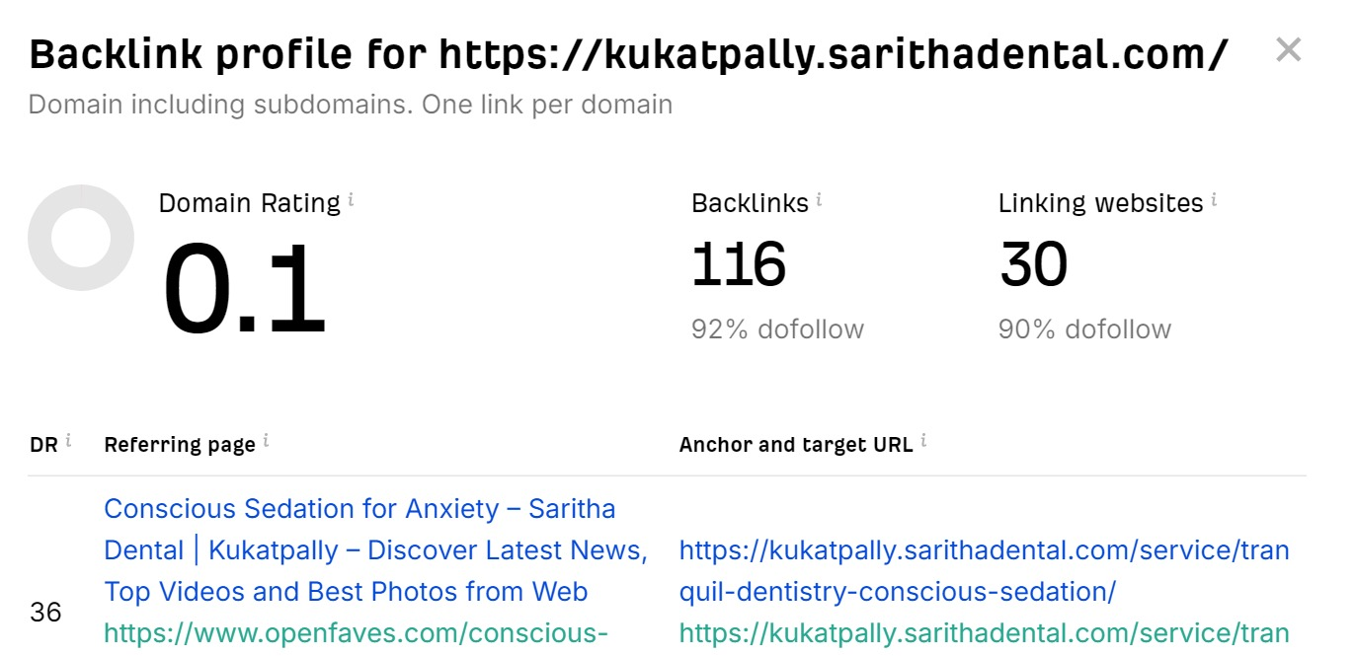
Competitors Of Uma Dental Clinic
04
03
Sridhar Dental
Saritha Dental

Slide 5
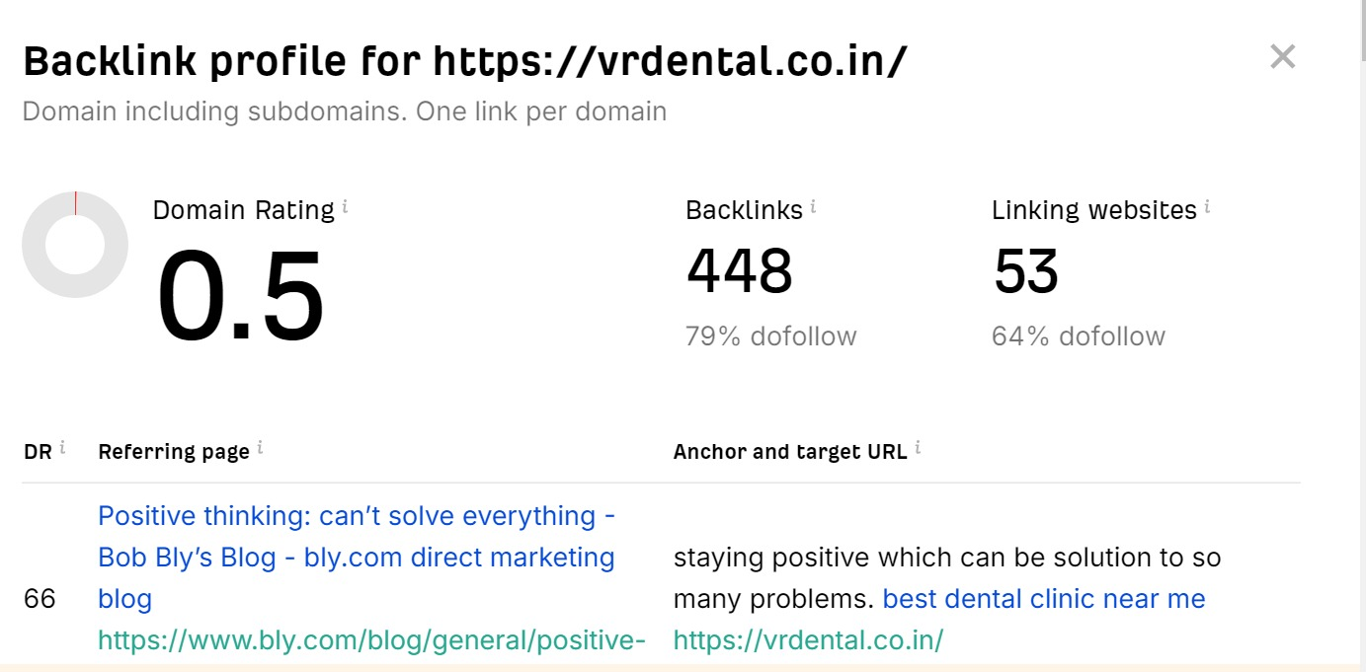
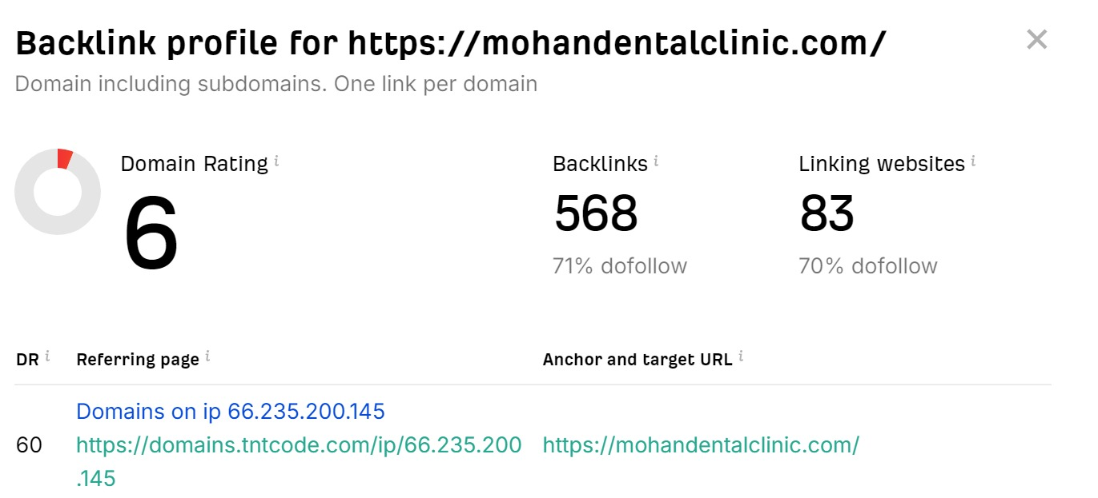
Competitors Of Uma Dental Clinic
06
05
Vr Dental
Mohan Dental

Slide 6
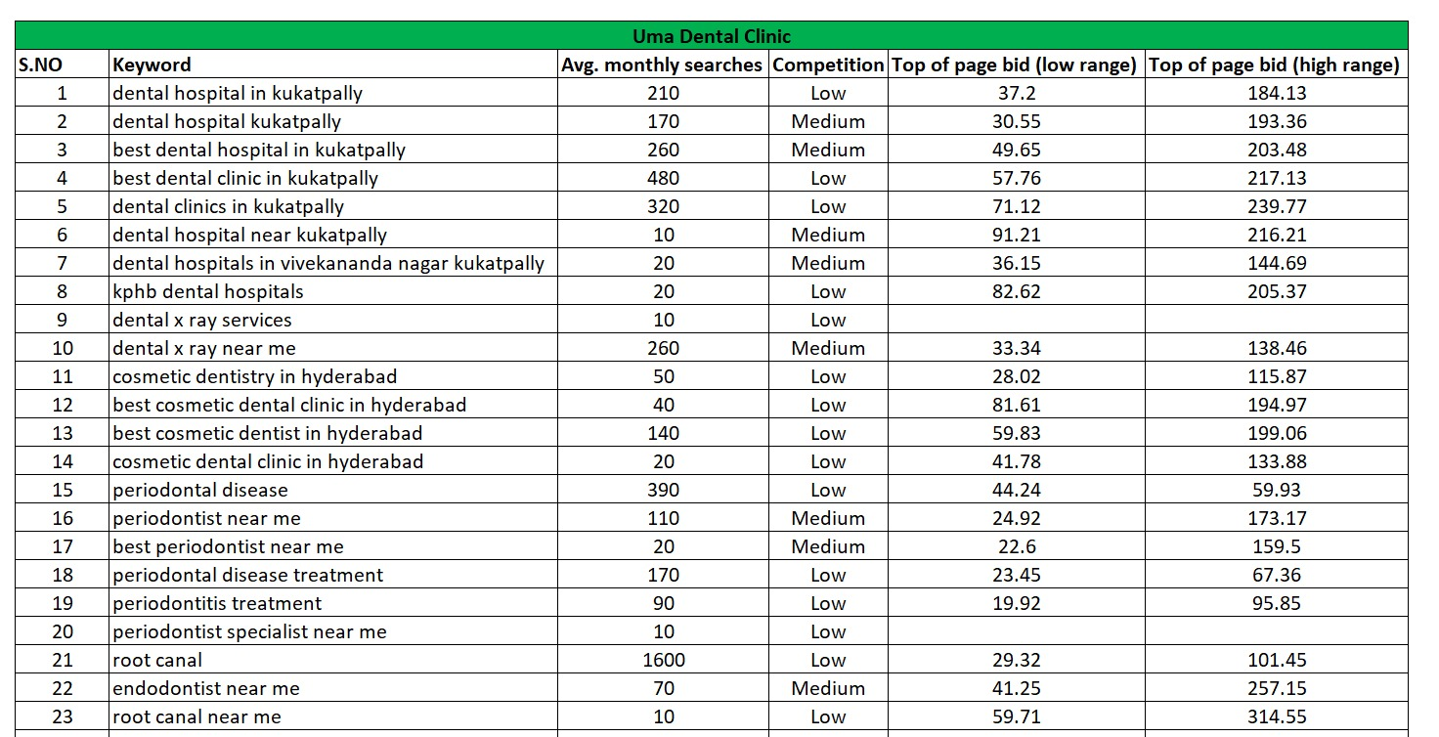
Keywords

Slide 7
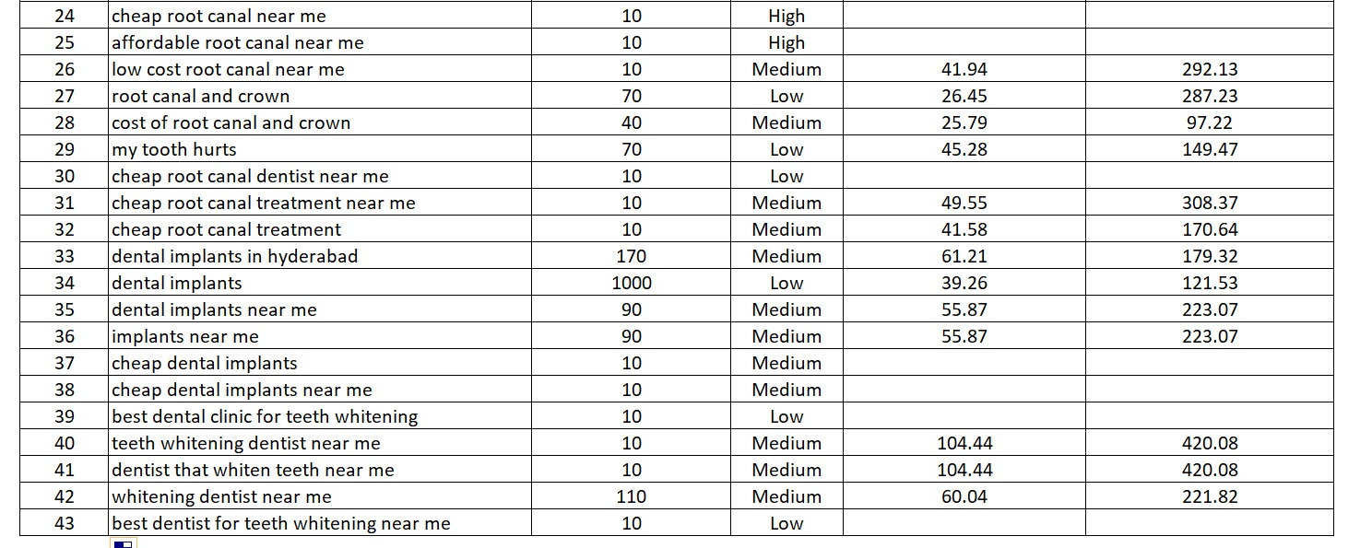
Keywords

Slide 8


Our Mission To The Uma Dental Clinic
Daily SEO Submissions
120 Backlinks Per Day
24 Working Days
120*24=2,880 Backlinks Per Month

Slide 9





Social Media Marketing
Monthly Social Media Postings In Facebook,LinkedIn, Instagram, YouTube & Twitter
20 Postings Per Month
4 Reels Per Month

Slide 10


Meta Ads And Google Ads
We Will Also Run Meta And Google Ads.
We Will Also Give 30 Reviews To Your Google My Business Profile.

Slide 11
Thank You!
Do you have any questions?
info@thepatternscompany.com
+91 8500693113
thepatternscompany.com

